Slide 1


CMR TECHNICAL CAMPUS UGC (Autonomous) Kandlakoya, Medchal Road, Hyd-501401 Department of Computer Science and Engineering
A
Mini Project On
FIGHTING AND GUNPOINT DETECTION
BATCH NO: 22
GROUP MEMBERS :
207R1A0595 M.Rishita Reddy
207R1A0580 Guglavath Srishanth
217R5A0508 Maripedda Praveen
UNDER THE GUIDENCE OF:
Ms.Saba Sultana
(Assistant Professor)

Slide 2
ABSTRACT
Surveillance videos are able to capture a variety of realistic anomalies. In this paper, we propose to learn anomalies by exploiting both normal and anomalous videos.
To avoid annotating the anomalous segments or clips in training videos, which is very time consuming, we propose to learn anomaly through the deep multiple instance ranking framework by leveraging weakly labelled training videos
We also introduce a new large-scale first of its kind dataset of 128 hours of videos. It consists of 1900 long and untrimmed real-world surveillance videos, with 13 realistic anomalies such as fighting, road accident, burglary, robbery, etc. as well as normal activities.

Slide 3
EXISTING SYSTEM
The success of sparse representation and dictionary learning approaches in several computer vision problems, researchers used sparse representation to learn the dictionary of normal behaviours.
During testing, the patterns which have large reconstruction errors are considered as anomalous behaviours.
Due to successful demonstration of deep learning for image classification, several approaches have been proposed for video action classification.
However, obtaining annotations for training is difficult and laborious,specifically for videos.
Recently, it used deep learning based auto encoders to learn the model of normal behaviours and employed reconstruction loss to detect anomalies.

Slide 4
Difficulty in Scalability
Limited Automation
Sensitivity to Dictionary Quality
DISADVANTAGES OF EXISTING SYSTEM

Slide 5
PROPOSED SYSTEM
We propose a MIL solution to anomaly detection by leveraging only weakly labelled training videos. We pro- pose a MIL ranking loss with sparsity and smoothness constraints for a deep learning network to learn anomaly scores for video segments.
We introduce a large-scale video anomaly detection dataset consisting of 1900 real-world surveillance videos of 13 different anomalous events and normal activities captured by surveillance cameras. It is by far the largest dataset with more than 25 times videos than existing largest anomaly dataset and has a total of 128 hours of video
Our dataset also serves a challenging benchmark for activity recognition on untrimmed videos, due to the complexity of activities and large intra-class variations. We pro- vide results of baseline methods, C3D [37] and TCNN [21], on recognizing 13 different anomalous activities.

Slide 6
ADVANTAGES OF EXISTING SYSTEM
LARGE SCALE DATASET
DIVERSE ANAMALOUS EVENTS

Slide 7
SYSTEM REQUIREMENTS
HARDWARE REQUIREMENTS:
System : Pentium IV 2.4GHz.
Hard Disk : 40 GB.
Floppy Drive : 1.44 Mb.
Monitor : 14’ Colour Monitor.
Mouse : Optical Mouse.
Ram : 512 Mb.
SOFTWARE REQUIREMENTS:
Operating system : Windows 7 Ultimate.
Coding Language : Python.
Front-End : Python.
Designing :HTML,CSS,Javascript.
Data Base : MySQL.

Slide 8
NOVELTY
The novelty of project lies in proposing a multiple instance learning (MIL) solution to anomaly detection by
leveraging only weakly labelled training videos. This approach considers both normal and anomalous videos
as bags, and video segments as instances, and learns a deep anomaly ranking model that predicts high anomaly
scores for anomalous video segments.
Another important aspect of your project is the introduction of a new large-scale dataset of 128 hours of videos,
which includes 1900 real-world surveillance videos of 13 different anomalous events and normal activities captured by
surveillance cameras. This dataset is the largest of its kind, with more than 25 times the number of videos compared to
existing datasets, and serves as a challenging benchmark for activity recognition on untrimmed videos, due to the
complexity of activities and large intra-class variations.
Overall, the project contributes to the field of video anomaly detection by proposing a novel MIL solution and
introducing a new dataset that can serve as a valuable resource for researchers and practitioners in this area.

Slide 9
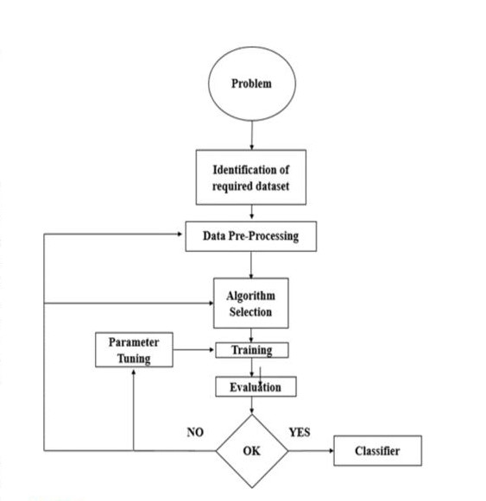
ARCHITECTURE

Slide 10
MODULES
Data Collection and Preparation:
- Gathering a large-scale dataset of surveillance videos, including normal activities and various anomalies.
- Preparing the dataset by organizing and annotating the videos according to their labels (normal or anomalous).
Multiple Instance Learning (MIL):
- Formulating the problem as a multiple instance learning (MIL) framework, where normal and anomalous videos are treated as bags and video segments as instances.
- Designing the architecture of a deep learning network to learn anomaly scores for video segments.

Slide 11
Deep Anomaly Ranking Model:
- Developing a deep anomaly ranking model that predicts high anomaly scores for anomalous video segments.
- Incorporating sparsity and temporal smoothness constraints into the ranking loss function to enhance anomaly localization during training.
Weakly Labeled Training:
- Utilizing weakly labeled training videos where the labels are at the video-level rather than the cliplevel.
- Training the deep anomaly ranking model using the weakly labeled training data.
Anomaly Detection and Localization:
- Applying the trained model to detect anomalies in surveillance videos.
- Localizing the detected anomalies within the video segments using the sparsity and smoothness constraints.

Slide 12
UML DIAGRAMS
USE CASE DIAGRAMS:

Slide 13
CLASS DIAGRAMS:

Slide 14
SEQUENCE DIAGRAMS:

Slide 15
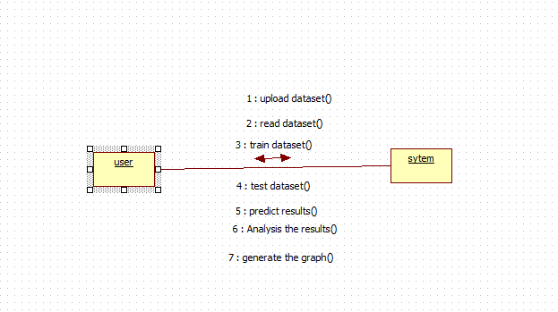
COLLABROATION DIAGRAMS:

Slide 16
ACTIVITY DIAGRAM:

Slide 17
DEPLOYMENT DIAGRAMS:

Slide 18
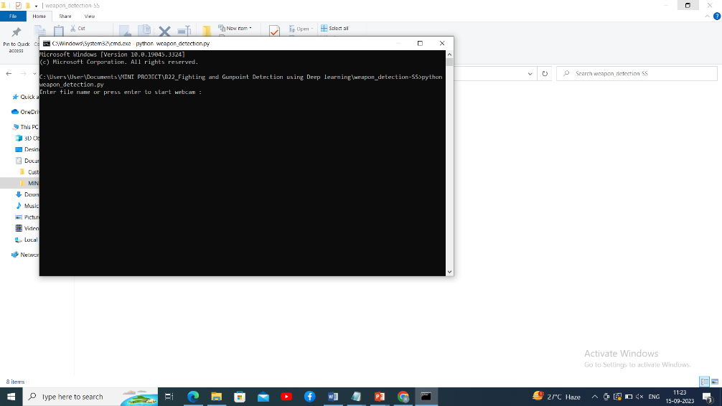
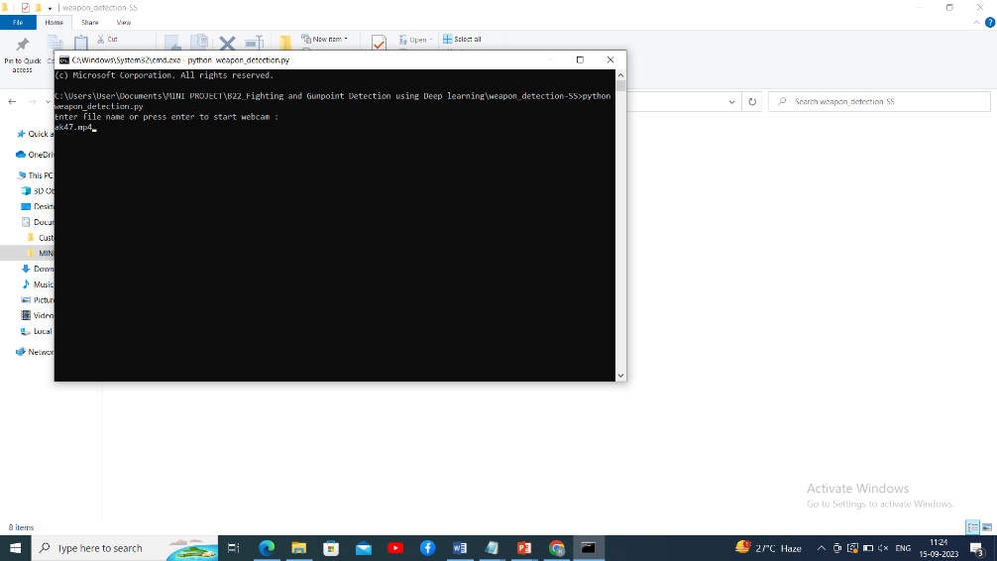
RESULTS

Slide 19
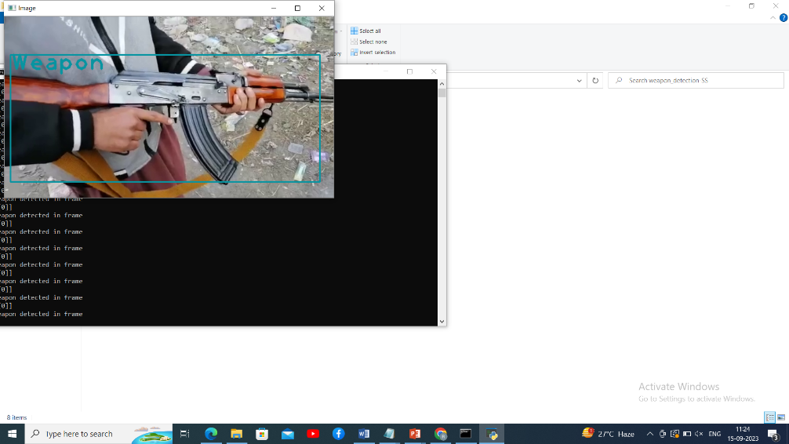
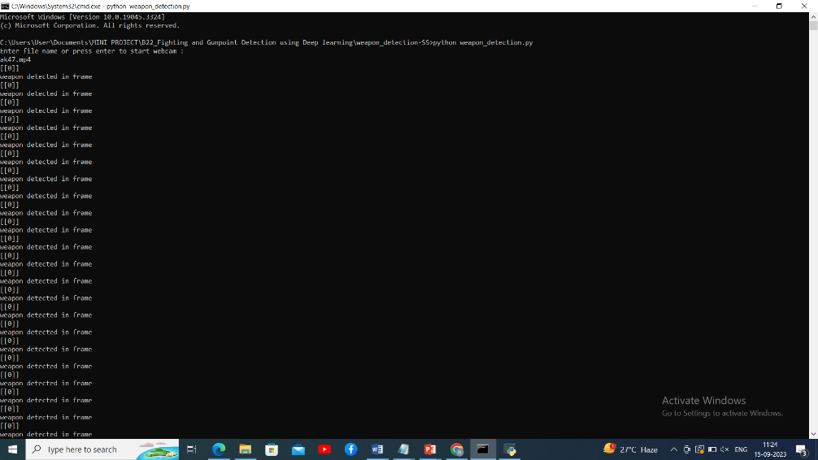

Slide 20
CONCLUSION
The main objective of this study is proposing a deep learning-based approach to detect guns, pistols and fight scenes from surveillance cameras in a fast and accurate way.
The presented solution deals with poor quality and low-resolution videos and images. Hence, it is appropriate for use with CCTV systems.
The proposed approach shows great performance and demonstrated its adaptability for being an automatic pistol and fight detection alarm system and the number of false positives is very low in all the video frames.
Another important contribution of the study is the collected surveillance camera fight and pistol dataset, which helps for automatic fight and pistol detection. This surveillance camera dataset can be extended by adding new samples from security camera footages on streets or underground stations.
In addition, we will try to reduce the number of false positives by applying some pre-processing steps before the feature extraction process and the classification process.

Slide 21
FUTURE SCOPE
The future scope of this project is wide-ranging and holds immense potential for further advancements in the field of video analysis.
Building on the foundation of Multiple Instance Learning (MIL) and the novel MIL ranking loss function with sparsity and smoothness constraints, future research can delve into more sophisticated deep learning architectures, such as attention mechanisms and transformer models, to achieve even higher accuracy in anomaly detection and activity recognition.
Moreover, expanding the dataset to encompass a broader spectrum of anomalies and activities, along with organizing benchmark challenges, will stimulate collaborative research and development.

Slide 22
REFERENCES
Muhammad Tahir Bhatti , Muhammad Gufran Khan , (Senior Member, IEEE), Masood Aslam , and Muhammad Junaid Fiazi (Weapon Detection in Real- Time CCTV videos using Deep Learning.)
Weapon Detection using Artificial Intelligence and Deep Learning for Security Applications by Mohana and Ayush Jain.

Slide 23
GITHUB LINK
https://github.com/praveen7036/weapon-detection

Slide 24
THANK YOU

